Slide 1


Arabic Emotion Detection
using AraBERT
Zahraa Salim
Hala Zayour

Slide 2

Introduction
What is Emotion Detection?
Identifying and classifying the emotional tone expressed in text.
Crucial for sentiment analysis, customer feedback, social media monitoring, etc.
Goal: Automatically detect emotions in Arabic text using NLP.
Motivation: Emotion detection enhances sentiment analysis, Chabot intelligence, and content moderation.
Language Focus: Arabic (rich, complex, and underrepresented in NLP).

Slide 3
Challenges &Objective
Challenges with Arabic NLP:
Rich morphology, dialectal variations, and complex orthography.
Limited availability of high-quality annotated datasets compared to English.
Project Objective:
To develop and evaluate an emotion detection model for Arabic text using the AraBERT model.
Leverage transfer learning for improved performance on limited datasets.

Slide 4


Dataset
Source: SemEval 2018 Task 1 (Subtask 5: Arabic)
Structure:
Train, Test, Validation splits.
Labels: 11 emotions (e.g., anger, joy, sadness, surprise).
Example Columns:
Tweet: Raw text input.
text: Processed text.
Emotion labels (binary columns).

Slide 5
Challenges & Solutions
Challenges:
Arabic dialects and script variations.
Data imbalance.
Solutions:
Use Camel Tools for normalization.
Apply class weights during training.

Slide 6




Dataset
1. Features: ['anger', 'anticipation', 'disgust','fear','joy', 'love', 'optimism', 'pessimism', 'sadness', 'surprise', 'trust']
2. Shape: datasets/train_dataset.csv - Original shape: (2278, 13)
datasets/test_dataset.csv - Original shape: (1518, 13)
datasets/valid_dataset.csv - Original shape: (585, 13)

Slide 7
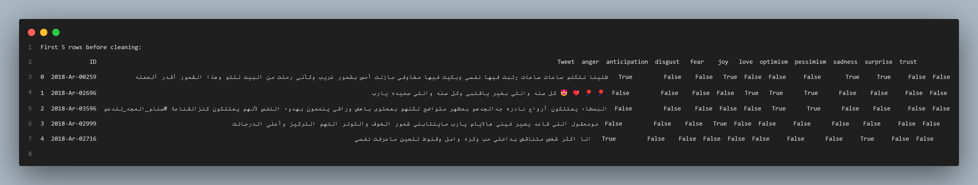
Dataset Sample:

Slide 8
Data Preprocessing
Text Cleaning:
Remove mentions (@user), URLs, numbers, and RT/cc tags.
Filter non-Arabic characters.
Hashtag Handling:
Split hashtags into meaningful words (e.g., #HappyDay → Happy Day).
Arabic Normalization:
Normalize Alefs (أ, إ, آ), Teh Marbuta (ة → ه).
Filtering:
Remove empty/duplicate texts and tweets with ≤3 words.
Tools: camel_tools for Arabic text normalization.

Slide 9
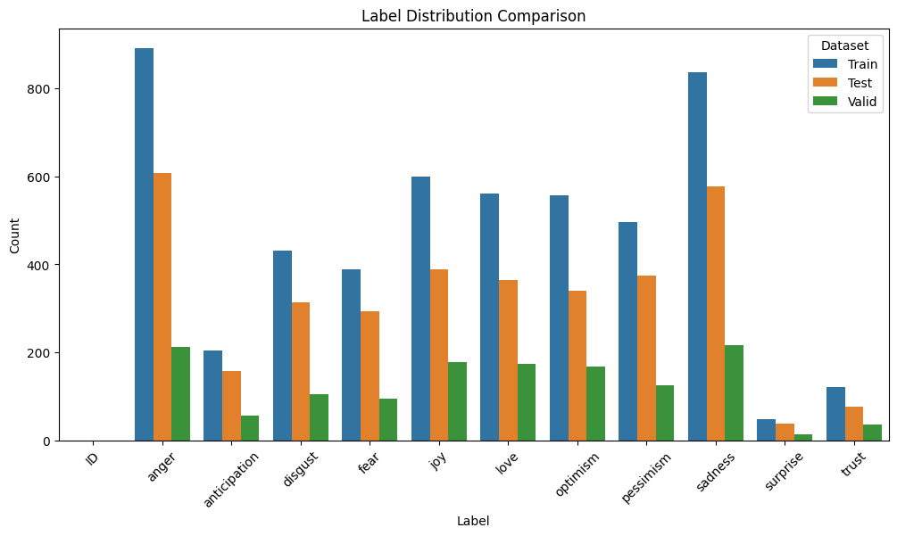
Emotion Label Distribution Across Train, Test, and Validation Sets
This bar chart compares the distribution of emotion labels in the training, testing, and validation datasets, showing that "anger" and "sadness" are the most frequent labels across all subsets. The distribution appears imbalanced, with some emotions like "surprise" and "trust" occurring much less frequently.

Slide 10
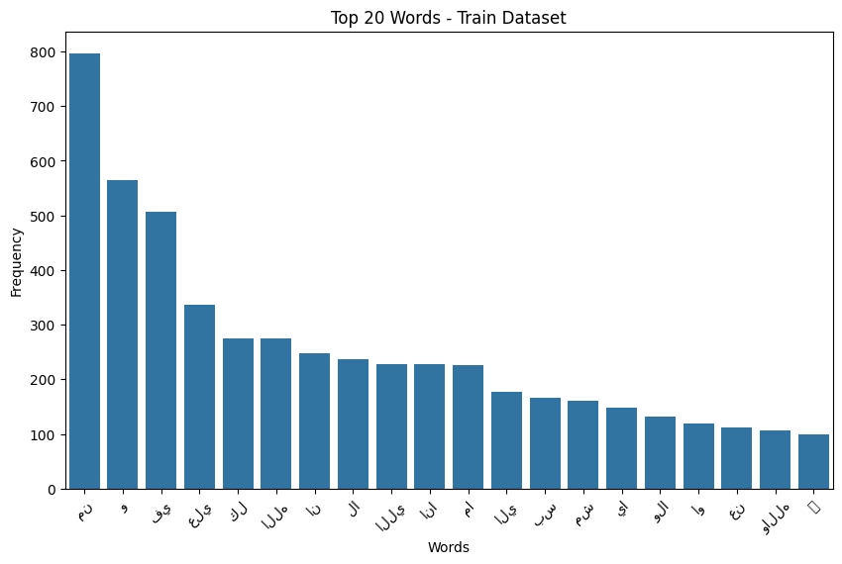
Top 20 Most Frequent Words in the Train Dataset
This bar chart shows the 20 most frequent words found in the training dataset, with the word on the far left appearing nearly 800 times. The frequency of words declines gradually from left to right, indicating a typical distribution where a few words dominate usage.

Slide 11
Model – AraBERT
Why AraBERT?
Pre-trained on diverse Arabic text (MSA + dialects).
Captures context-aware embeddings.
AraBERT is ideal for Arabic NLP because it combines linguistic diversity with deep contextual understanding
Fine-Tuning Steps:
Tokenize text with AraBERT tokenizer.
Add a classification layer (11 emotions).
Train using TensorFlow/Keras.
version used:
aubmindlab/bert-base-arabertv02-twitter

Slide 12
Training
Tokenized dataset using AraBERT tokenizer
Trained using:
Adam optimizer
Cross-entropy loss
Batch size: 32
Epochs: 20
Accuracy and loss tracked during training

Slide 13
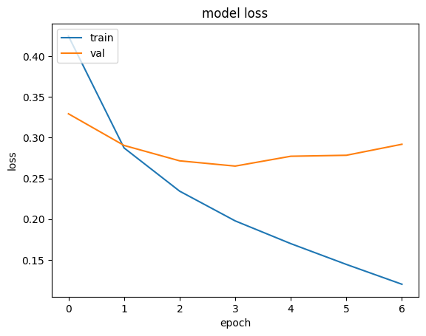
Training vs Validation Loss Over Epochs
The graph displays the training and validation loss of a model across seven epochs. While the training loss consistently decreases, the validation loss stops improving after epoch 3 and begins to slightly increase, suggesting potential overfitting.
Hamming Loss: 0.11896000482596368
--> Indicates reasonably good performance

Slide 14
Results
Achieved high accuracy in detecting emotions like:
Happiness
Anger
Sadness
Sample output:
Tweet: "أنا فرحان جدًا اليوم"
Predicted Emotion: Happiness

Slide 15
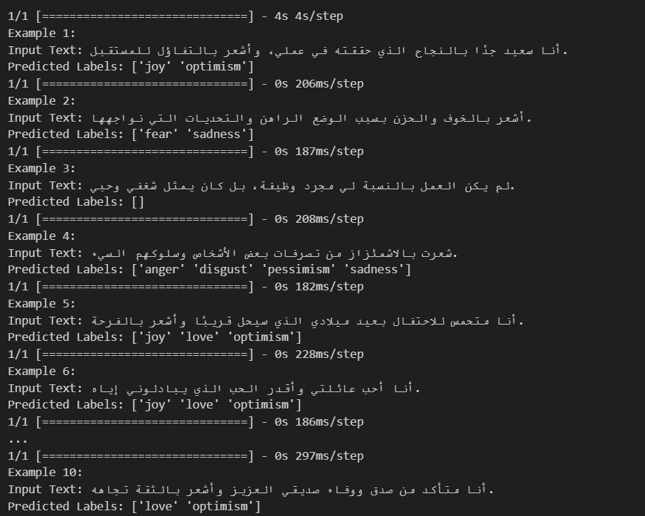
The model demonstrates a generally accurate understanding of sentiment and emotions in Arabic text, correctly identifying positive emotions like joy, love, and optimism in upbeat inputs (e.g., Examples 1, 5, 6, and 10), and negative emotions such as fear, sadness, anger, and disgust in more pessimistic or troubling statements (e.g., Examples 2 and 4). Overall, the model performs well on clear emotional expressions

Slide 16
Classification Report Generator using Scikit-learn.
Precision – How many of the predicted positives were actually correct
Recall – How many of the actual positives were correctly predicted
F1-score – Harmonic mean of precision and recall
Support – Number of true instances for each class
Jaccard index – Evaluate the similarity between two sets
It summarizes the performance of a classification model. It shows:

Slide 17
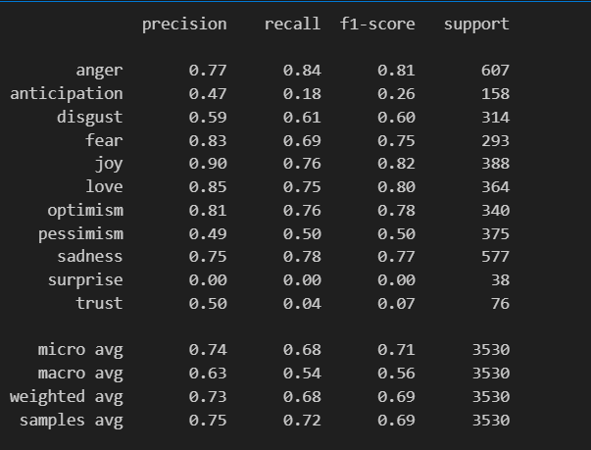
The model is highly effective at predicting frequent emotions (joy, anger, love, optimism).
Struggles with rare or ambiguous emotions (surprise, trust, anticipation).
Consider data augmentation or re-balancing the dataset for rare emotions, and improving contextual modeling to capture subtler emotions.
Jaccard index: 0.5553929945121211
This is a moderate score, indicating that the model's predictions are somewhat aligned with the true labels but there's still noticeable room for improvement.

Slide 18
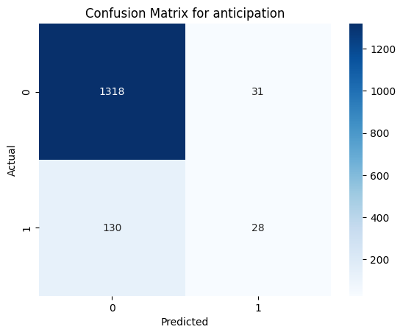
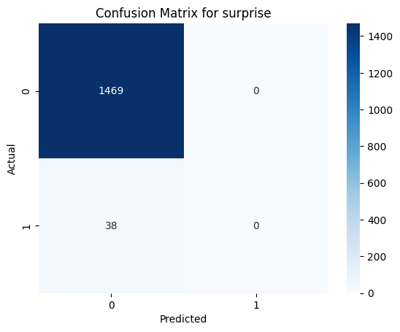
Conffusion Matrix

Slide 19
Conclusion
Successfully built an Arabic emotion detection model using AraBERT
Preprocessing and fine-tuning are critical
Opens possibilities for Arabic AI applications

Slide 20
Thank You for Your Attention!

